Slide 1
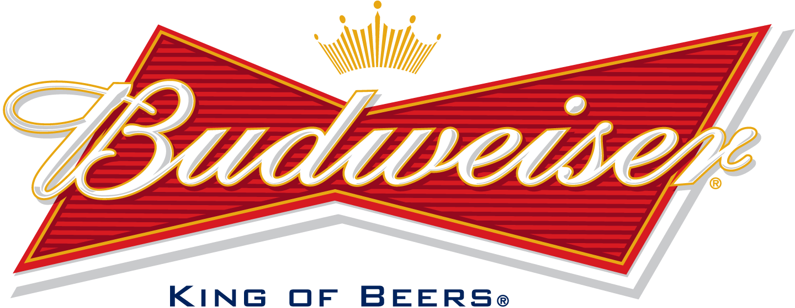
Case Study 1
Gobra Analytics
Christopher Dawson
Dhruba Dey

Slide 2
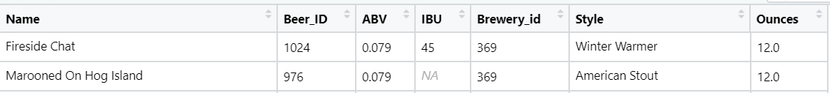
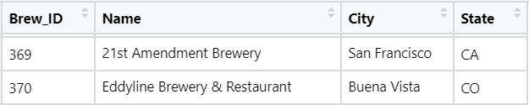
Overview
Objective of this project is to conduct exploratory data analysis of key attributes of beers and their respective breweries; finding and leveraging relationships within the data. Using this data we were able to classify style of beer, IPA vs other Ales, provided alcohol content (ABV) and measure bitterness (IBU).
ABV (Alcohol by Volume) presents alcohol content is a popular attribute of beer and used to designated certain style
IBU (International Bitterness Unit) qualifies the taste of beers and influences in designating beer style
Beer style provides us Info such Ale , Stout etc. But our focus is on Ale vs non-Ale
Ounces represents container sizes. 3 categories – 8.4, 12, 16
Beers.csv
Breweries.csv

Slide 3
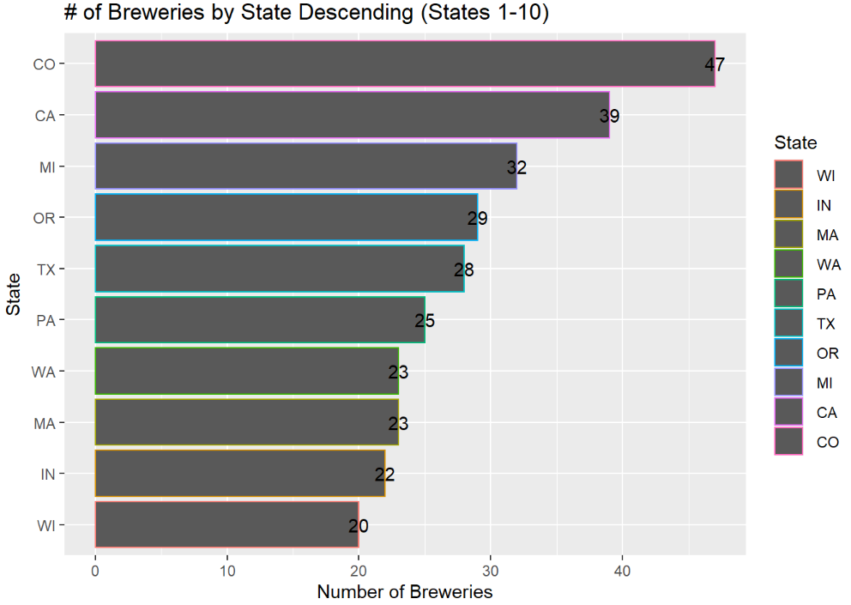
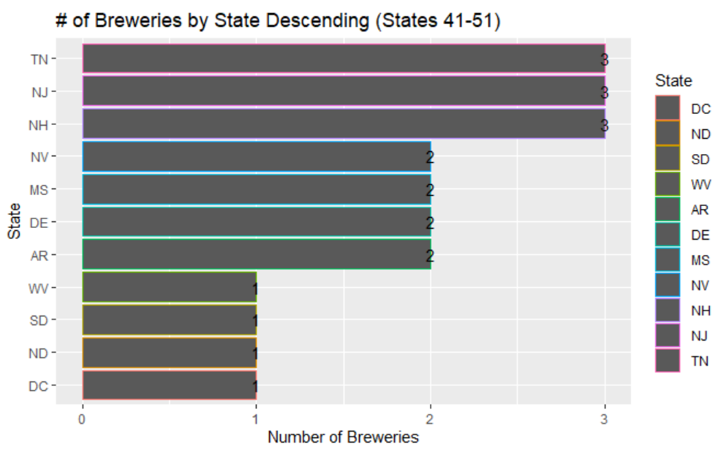
EDA
558 breweries present in the dataset
Notes:
CO home of craft beer and Coors, has One of the largest brewing industries (per capita) in the country.
Denver, CO was started in a small saloon and was the largest brewery between St. Louis and San Francisco in the mid 1800s.
High Volume States benefit from lax laws and oversight, while DC, ND, Strict Laws and monitoring;
Some requiring states that forbids small breweries from directly distributing beer products.
Small breweries are required to use a distributor, per South Dakota law.

Slide 4
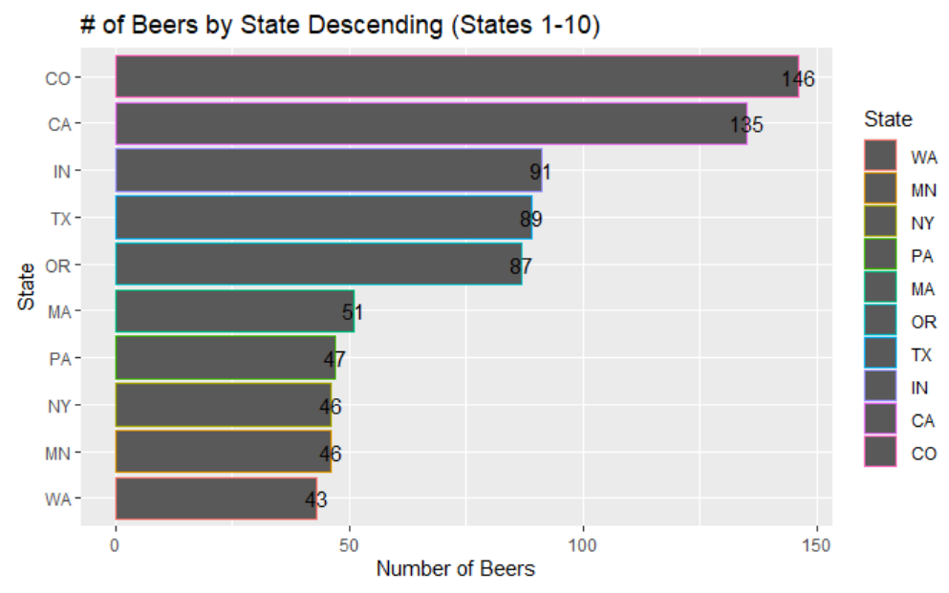
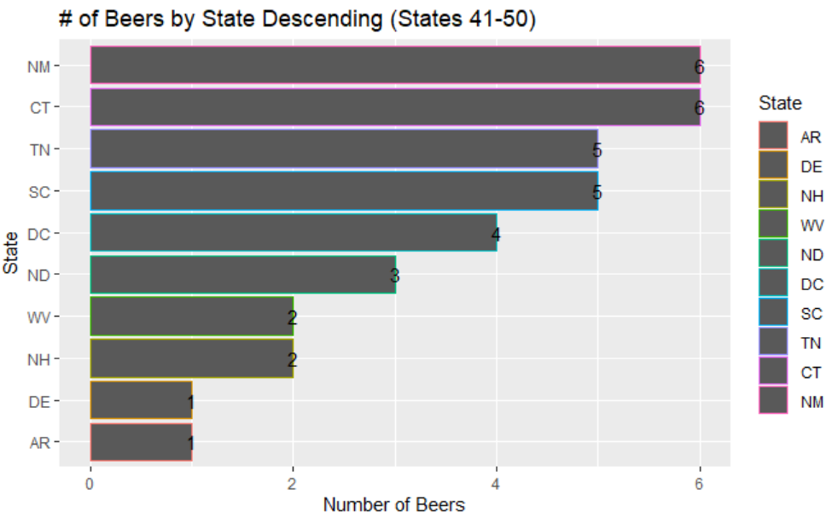
EDA
1405 distinct beers present in the dataset

Slide 5
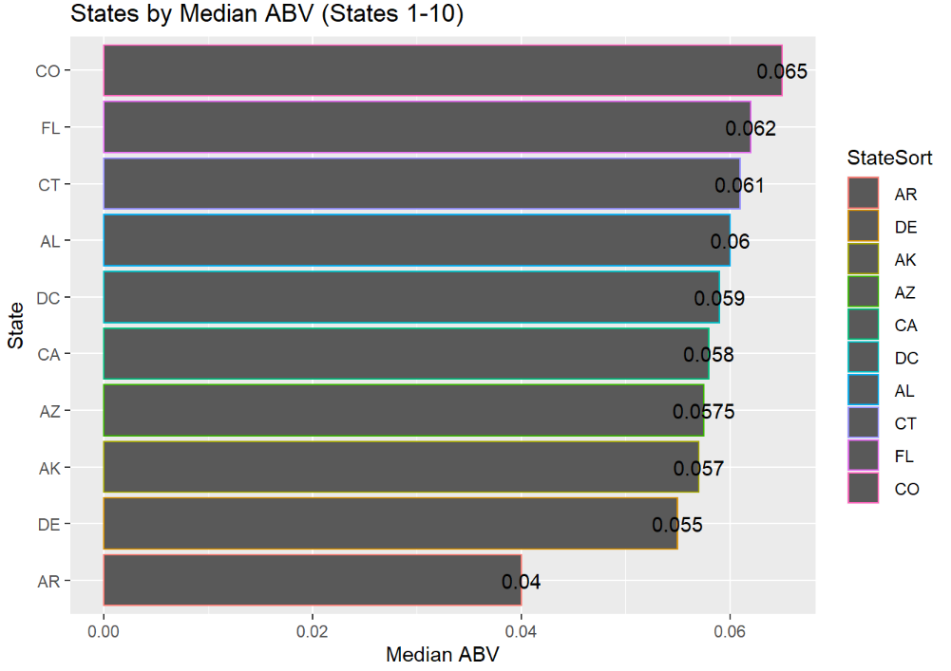
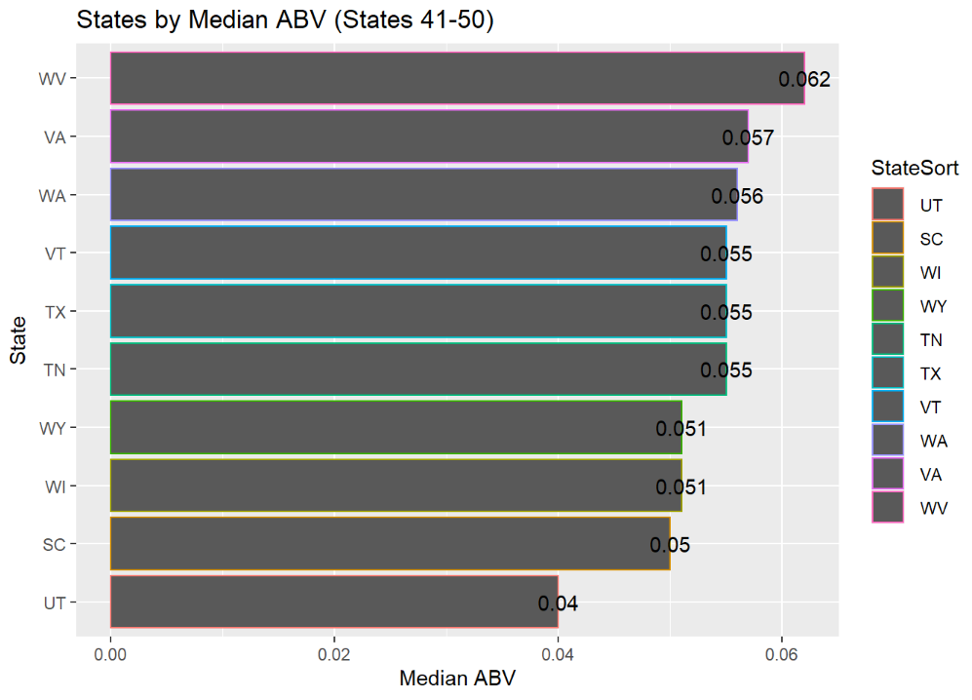
EDA
Removed the entire obs. if NA is found. # of obs before are 2410 and 1405 thereafter
State with the highest ABV : Kentucky (Alcohol content 12.5%)
Name : London Balling

Slide 6
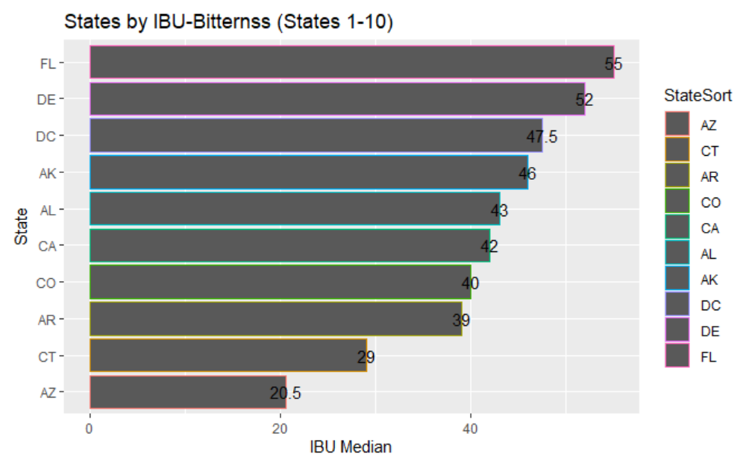
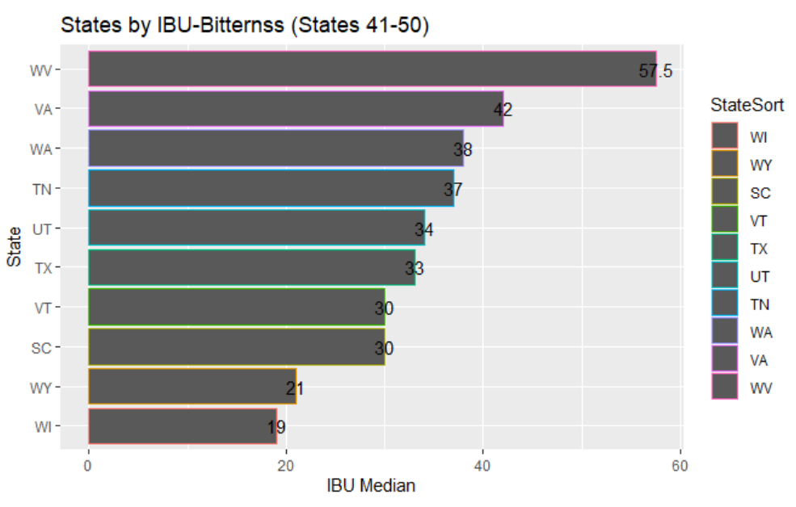
EDA
State with the highest IBU : Oregon (International Bitterness Unit 136)
Name : Bitter Bitch Imperial

Slide 7
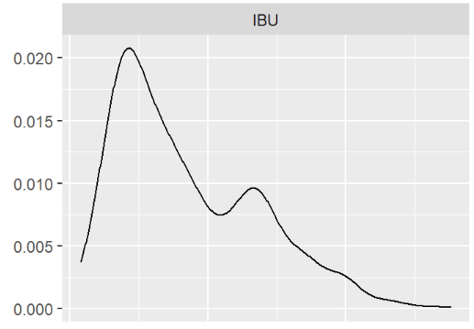
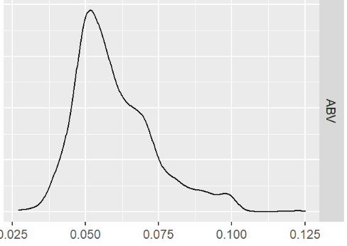
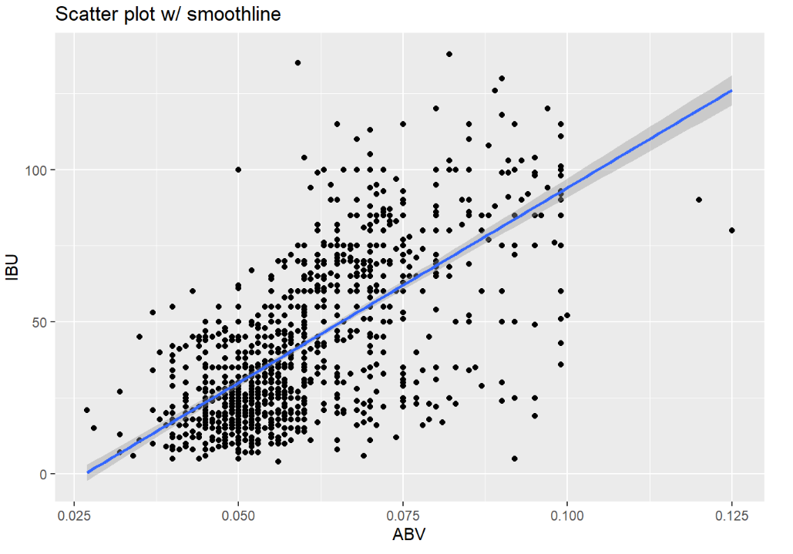
ABV & IBU – Distribution & Correlation
Distributions of ABV and IBU slightly right skewed
However, both are sort of normally distributed. Sample sizes are high for both. So, CLT holds well.
ABV is moderately and positively co-related with IBU. And Correlation Coefficient stands at 0.671

Slide 8
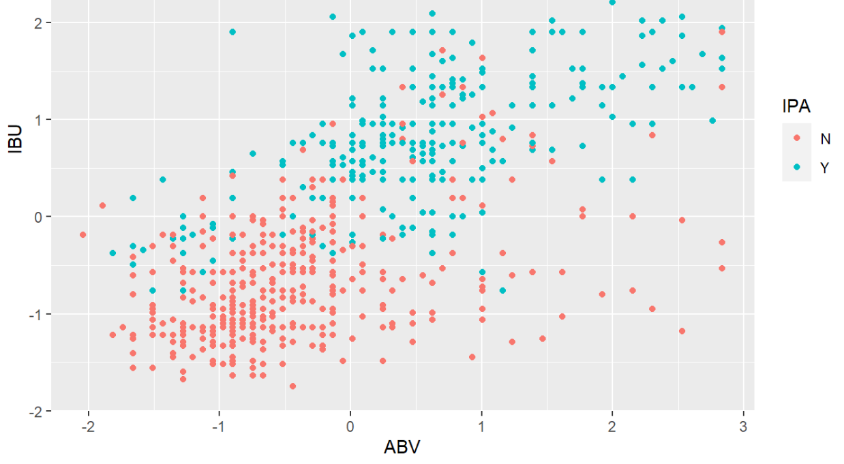
Classification Model (knn)
The standardized distribution of IPA Beers vs other Ale Beers shows correlation, but visually not more than 2 groups are easily identified.
Notes:
Nearest Neighbor and measured distance as input (x) vs response (y) variable
Recall the distribution of IPA Beers vs other Ales: the standardized visual inspection we can make out at least 2 groups, but not entirely clear bove 0.5 ABV and .5 IBU.
Other ale and IPA are scattered.

Slide 9
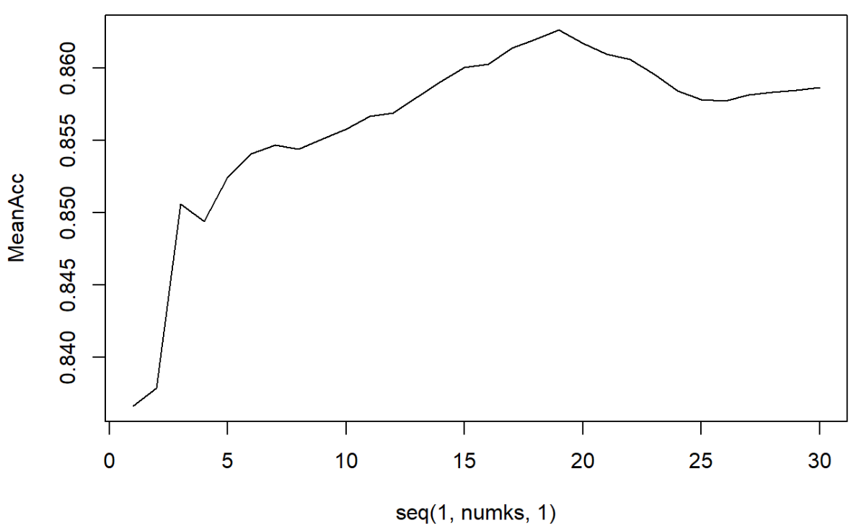
Classification Model (knn)
Groups = 19
Is it an IPA? | N | Y
N | 121 | 20
Y | 18 | 77
Precision = 87%
Recall = 85%
Accuracy = 84%
Sensitivity = 88%
Specificity = 74%
Notes:
## ## classifications
N Y
## N 123 25
## Y 16 72
## ## Sensitivity : 0.8849
## Specificity : 0.7423
## ## Accuracy : 0.8263
## Confusion Matrix and Statistics
## ## ## classifications N Y
## N 123 25 ## Y 16 72
## 95% CI : (0.7718, 0.8724)
## No Information Rate : 0.589
## P-Value [Acc > NIR] : 4.489e-15
## ## Kappa : 0.6361
## ## Mcnemar's Test P-Value : 0.2115
## Pos Pred Value : 0.8311
## Neg Pred Value : 0.8182
## Prevalence : 0.5890
## Detection Rate : 0.5212
## Detection Prevalence : 0.6271
## Balanced Accuracy : 0.8136
## ## 'Positive' Class : N

Slide 10
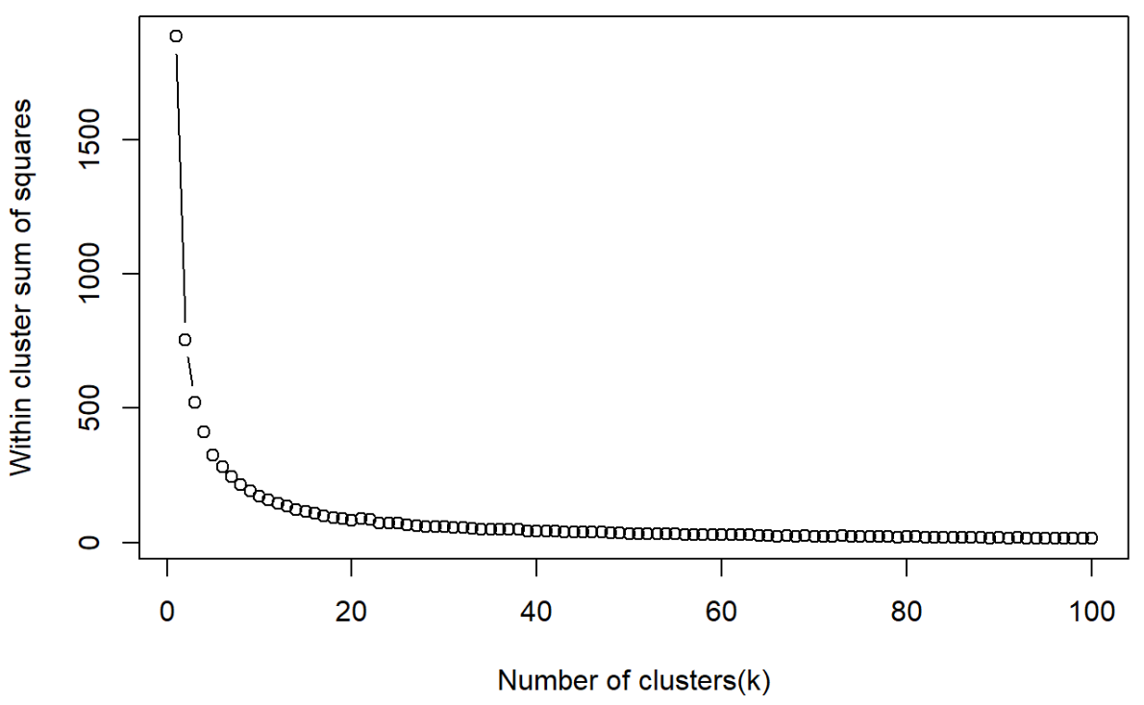
Classification (k-means)
Observed best k-means is 30 with little to no increased performance over 30 groups. Produced precision of 88.5% and recall of 83.5%; better precision and lowered recall compared to normal group classification.

Slide 11
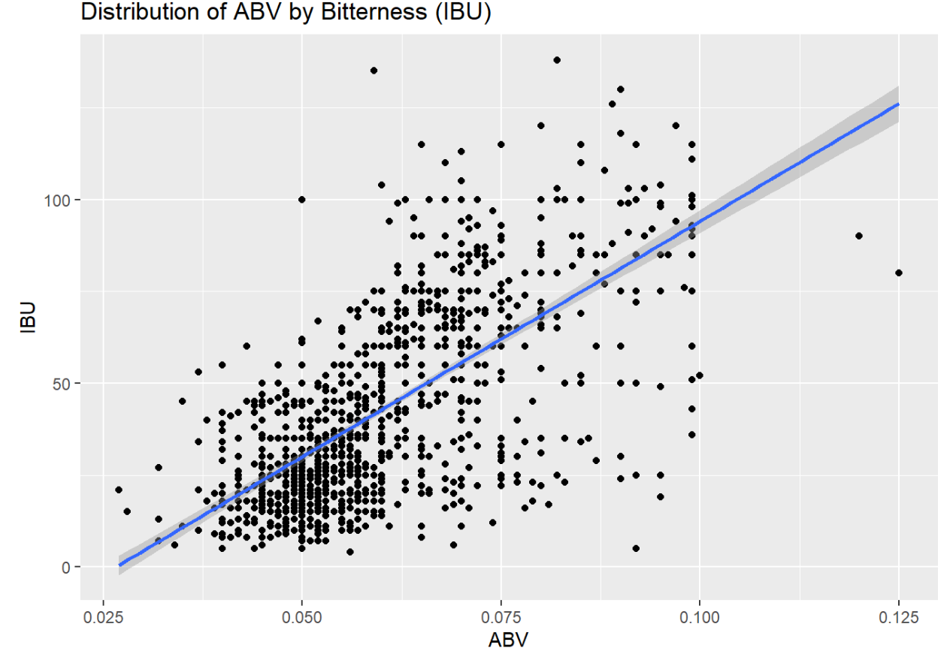
Classification (linear regression)
It is estimated that ~ 45% of the increase in Bitterness is explained by ABV. Variances where not equal between the IPA and Other Ale groups, with large residuals.

Slide 12
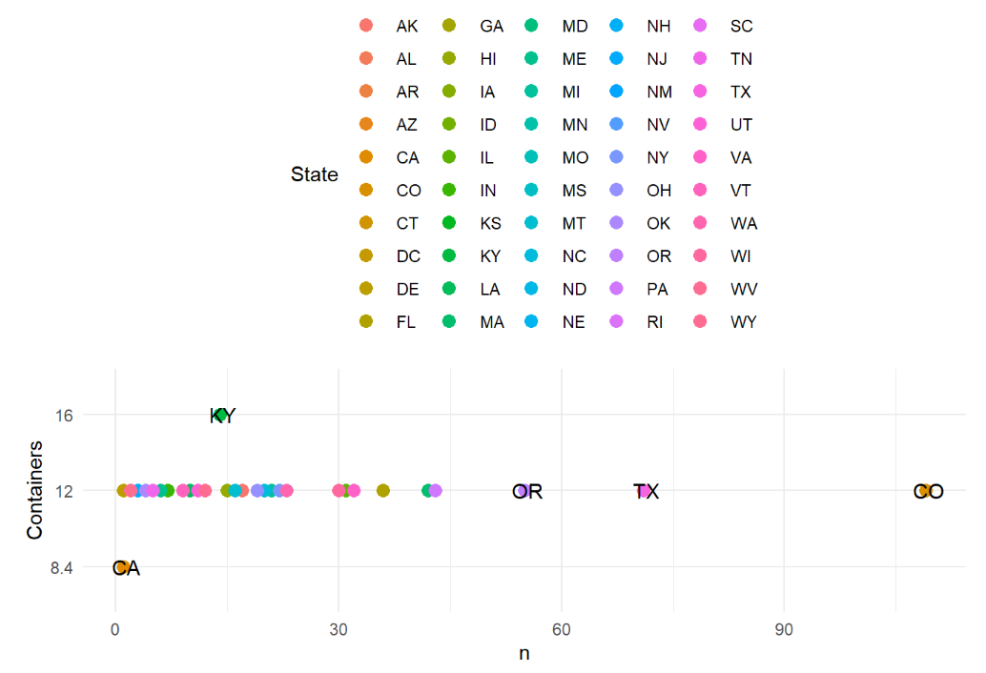
Container Size
12 ounce is the most popular container in United States as all states besides 2 states; KY & CA.
Notes:
California economics are tough, microbreweries to offer comforts beyond your basic bar —
a trend already visible in some of the Sacramento craft beer scene’s most recent additions are small and trendy; needing to find a niche in the right neighborhood, squeezing every ounce of profit margin.
Big breweries are going out of style fast.
Kentucky is the home of bourbon. There are many more craft distilleries that have legions of fans, all of them loyal to Kentucky whiskey.
And Kentucky is the home to Bourbon County, literally the home of American Bourbon production. The state even has its own Bourbon Trail specifically dedicated to highlighting the state's best bourbon.

Slide 13
Summary
EDA
# of Beers and Breweries direct result of local legislation and beer culture, e.g. CO & CA (high) vs DE & AR (low)
Classification
Relationship between IBU & ABV is moderately correlated, given positive relationship and distribution is slightly right skewed for both
Knn is recommended classification practice for identifying IPA vs other Ale beers using ABV & IBU
Additional Findings & Recommendations
General container size 12oz, except 2 states is good for bottling practice and manufacturing
Other explanatory variables to predict beer style

Slide 14
Thank you !!!

Slide 15
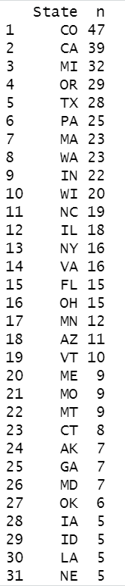
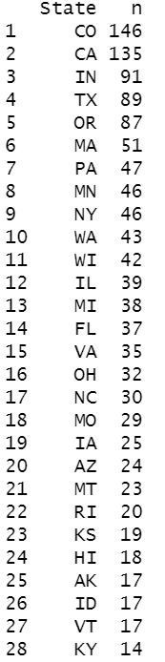
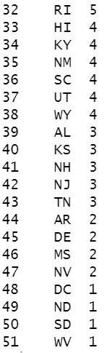
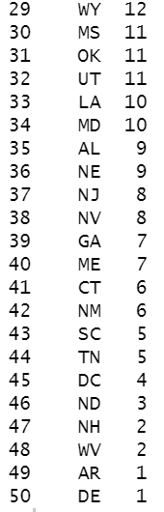
Appendix
# breweries by states
# beers by states

